Slide 1

On AI’s Impact — An Engineer’s Take
Daniel Khashabi
Notes:
Thank you for having me! It's an honor to be here!
I am an engineer by training, but today I won’t talk about engineering details. Instead, I want to share my perspective on the impact (including those positive and negative).
It goes without saying that, a lot of these are my speculations, which may be limited or likely biased. So, take everything with grain of salt.

Slide 2
Today?
What changed? Why is it moving quickly?
Where is the discussion of regulations heading?
What are the emerging risks?
Upsides and downsides in the intersection of AI + life science
High-consequence risks/solutions in AI-bio space.
What about AGI?

Slide 3
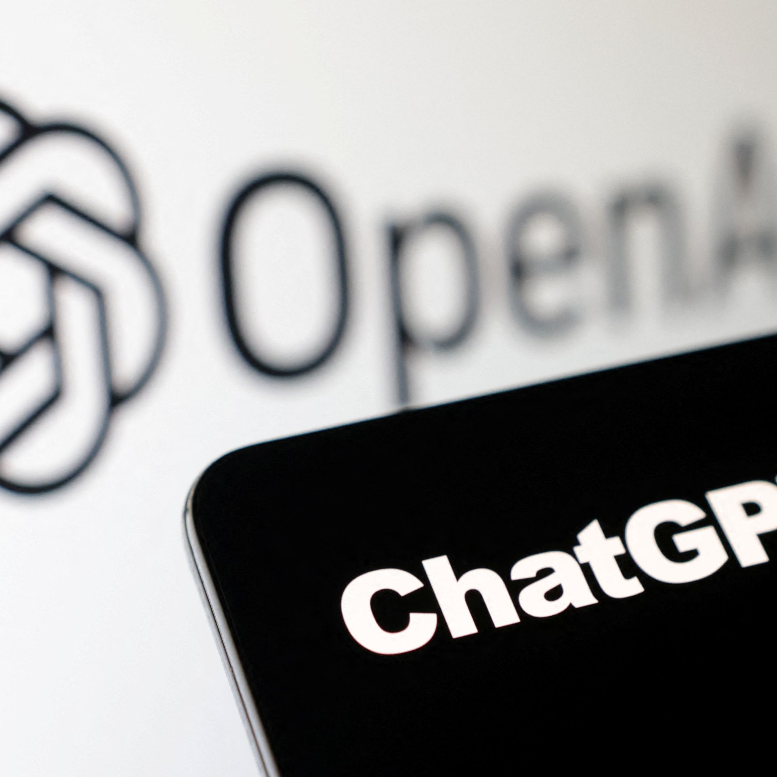
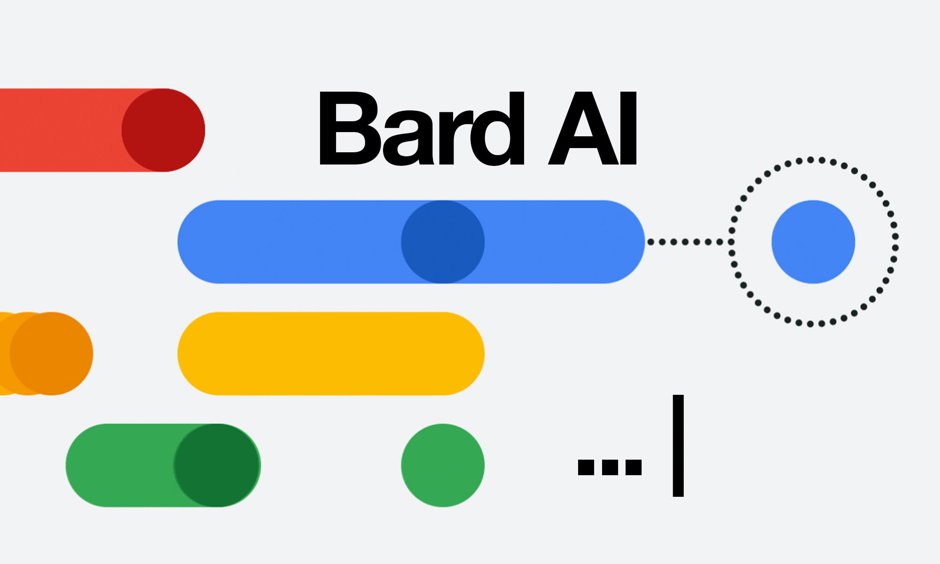
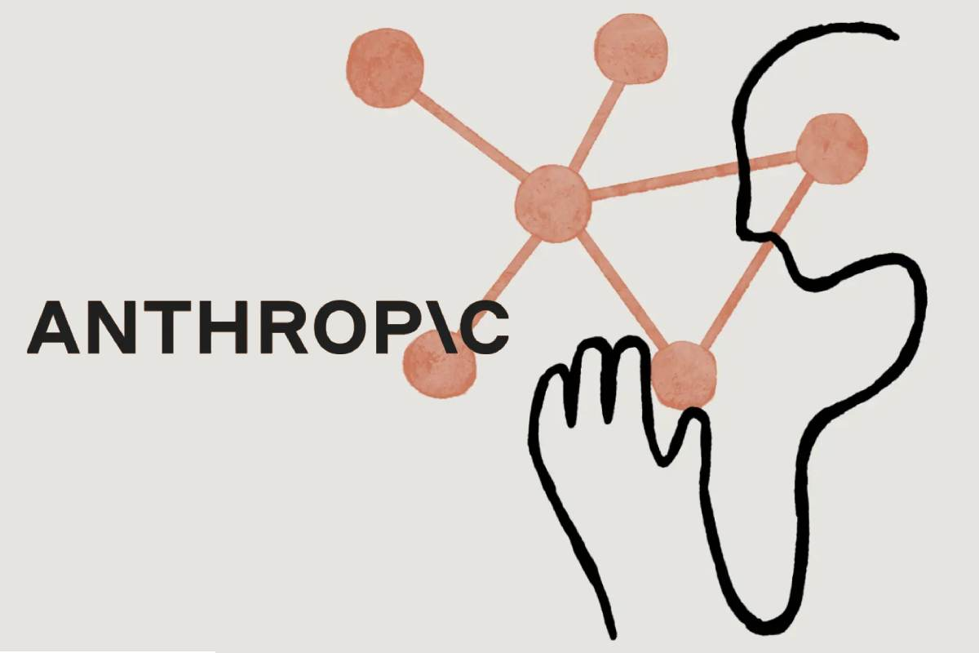

Chatbots are the buzz!!
Notes:
So, it goes without saying: chatbots driven by large language models are all the buzz these days.
And rightly so ….

Slide 4
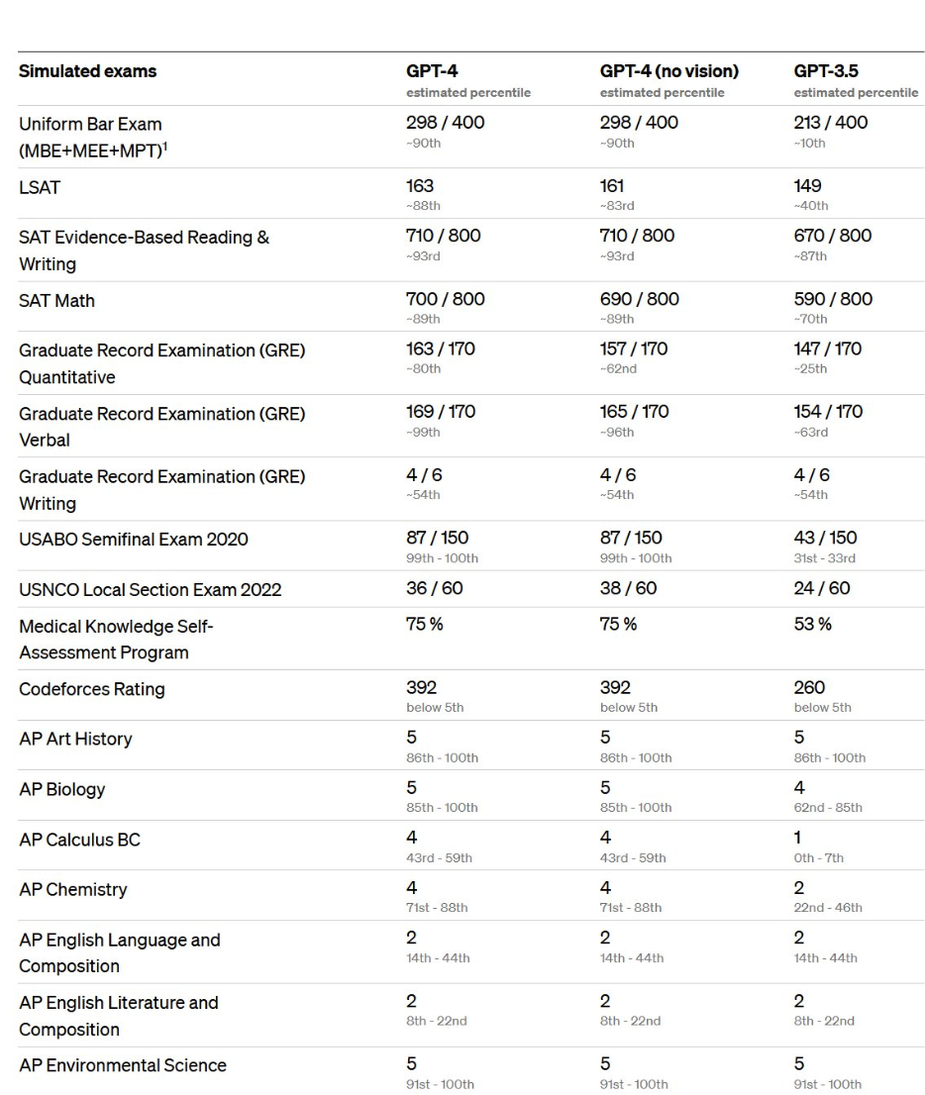
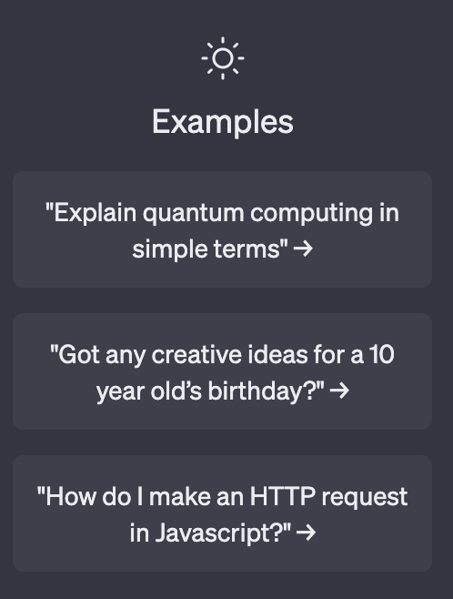
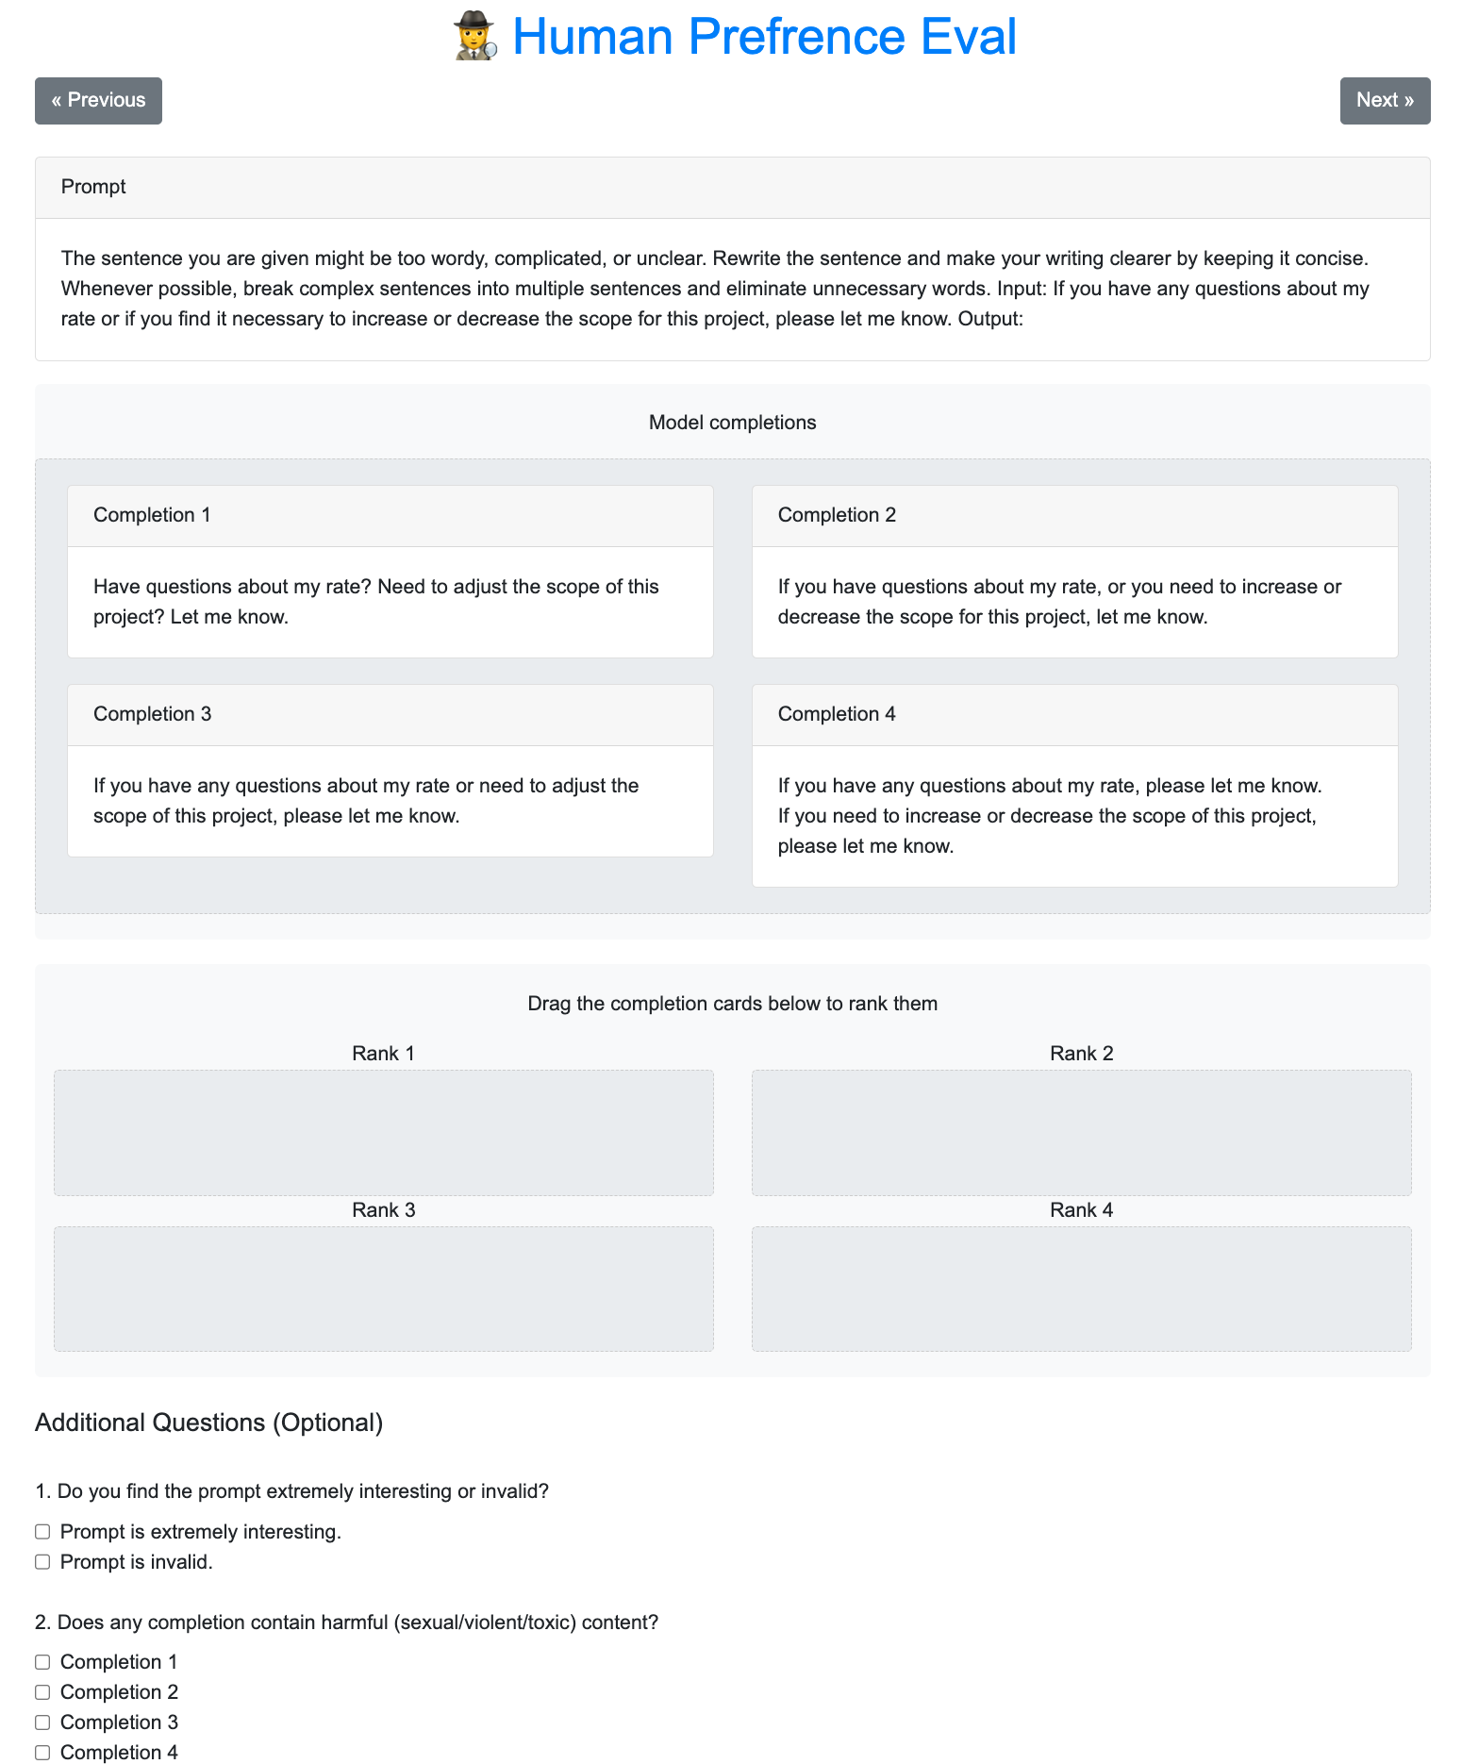
These Chatbots are Real Generalists!
Basic needs
Standardized exams
Writing a real website for me!
Notes:
They seem to have fluent dialogue, solve math problems, and ….
Pass standardized exams
Or even help us with building a website.
This is great! ….

Slide 5
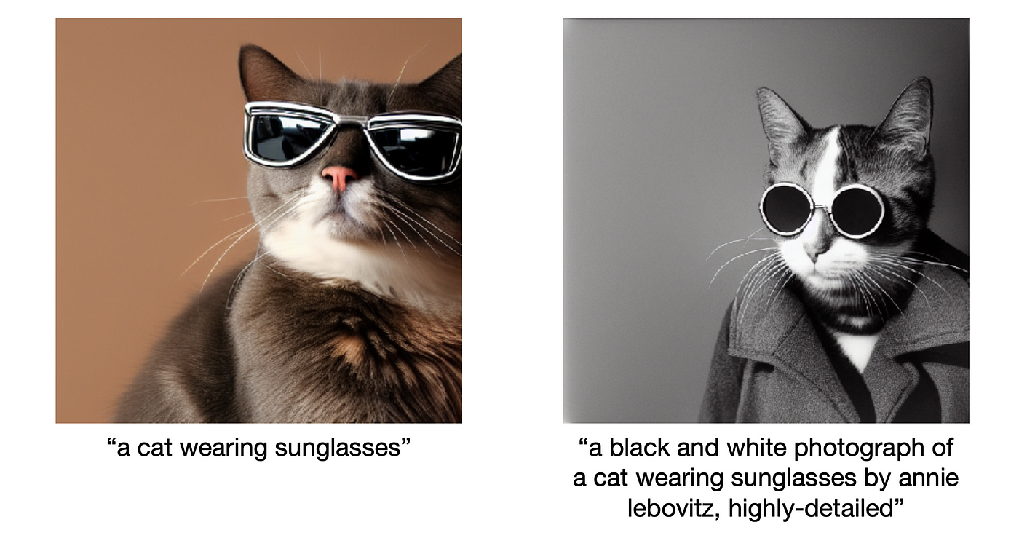

Slide 6
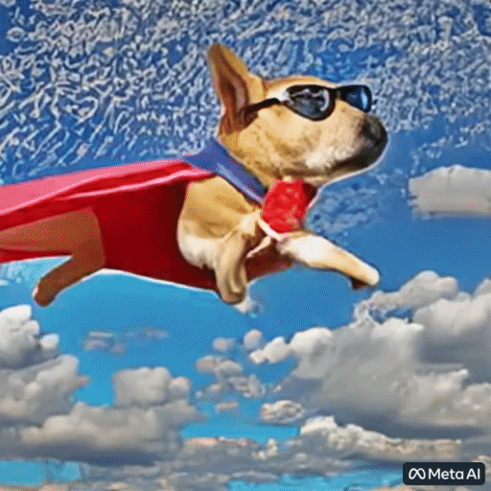

Slide 7
Self-Supervised Models
Notes:
…. which I am going to spend a few minutes to define.

Slide 8
Self-Supervision
Examples of the World
New Instances
🤖
Notes:
then a few more photos

Slide 9
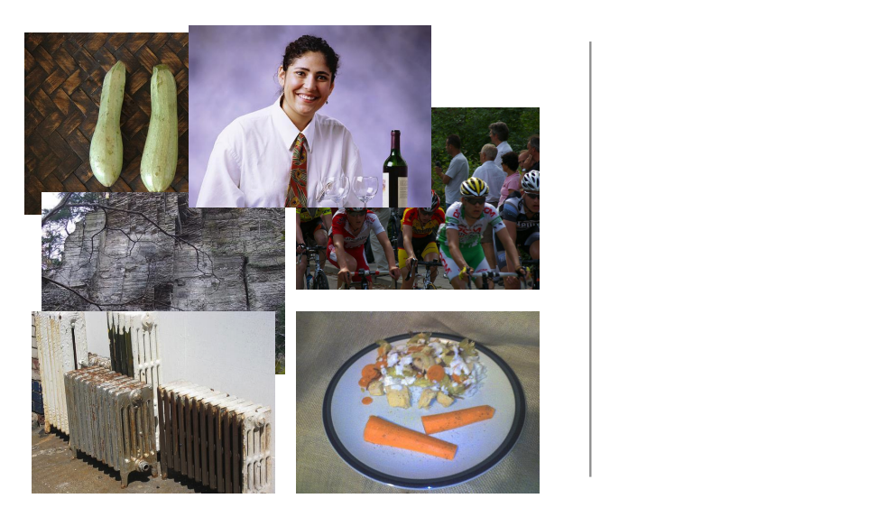
Self-Supervision
Examples of the World
New Instances
🤖
Notes:
then a few more photos

Slide 10
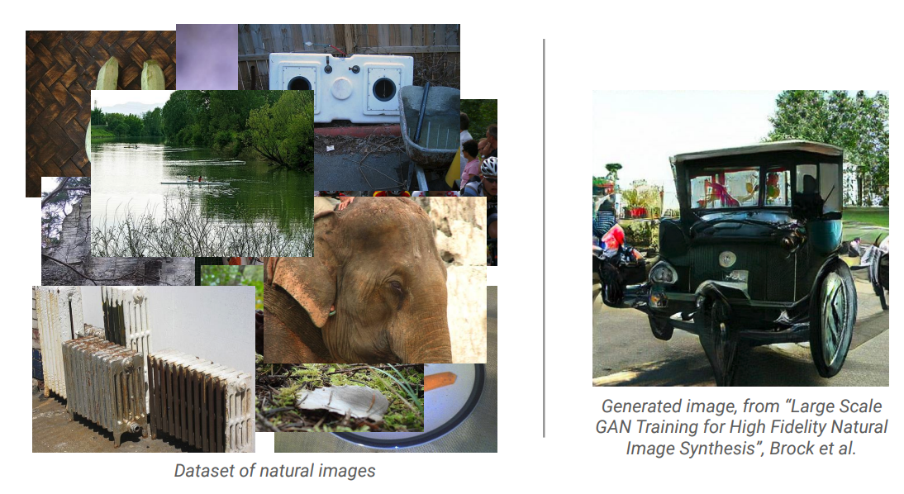
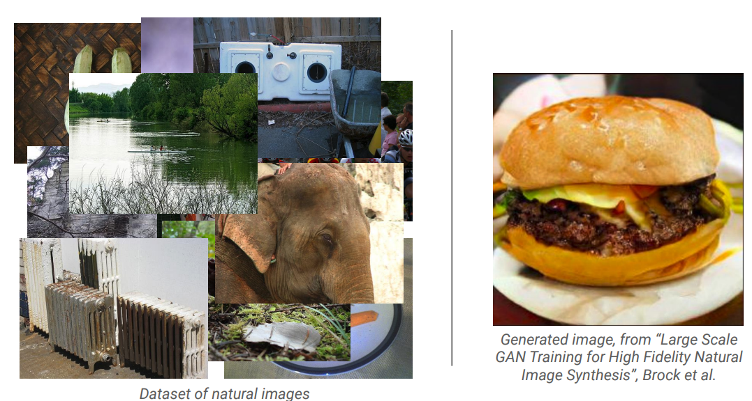
Self-Supervision
Examples of the World
New Instances
🤖
Notes:
then a few more photos

Slide 11
Self-Supervision
== lemon
The lemon (Citrus limon) is a species of small evergreen trees in the flowering plant family Rutaceae, native to Asia, primarily Northeast India (Assam), Northern Myanmar or China.[2] The tree's ellipsoidal yellow fruit is used for culinary and non-culinary purposes throughout the world, primarily for its juice, which has both culinary and cleaning uses.[2] The pulp and rind are also used in cooking and baking. ….
== wheelbarrow
A wheelbarrow is a small hand-propelled vehicle, usually with just one wheel, designed to be pushed and guided by a single person using two handles at the rear, or by a sail to push the ancient wheelbarrow by wind. The term "wheelbarrow" is made of two words: "wheel" and "barrow." "Barrow" is a derivation of the Old English "barew" which was a device used for carrying loads. The wheelbarrow is designed to …..
== wings over kansas wings over kansas is the second studio album by jason ammons, john bolster and mo rosato. the album debuted at number one on the billboard 200, selling 35,000 copies in it first week at the time. it was the second highest selling album to debut at the billboard top 50 and the third highest selling album to debut at the top heatseekers, with 26,000 copies sold. this is the supremes album earning the nickname …
== treaty of paris (1763) the treaty of paris, also known as the treaty of 1763, was signed on 10 february 1763 by the kingdoms of great britain, france and spain, with portugal in agreement, after great britain's victory over france and spain during the seven years' war. the signing of the treaty formally ended the seven years' war, known as the french and indian war in the north american theatre, ….
Examples of the World
New Instances
🤖
Notes:
then a few more photos

Slide 12
Self-Supervised Models
Are predictive models of the world.
Examples of the World
New Instances
🤖
Notes:
Generation is not just the product of AI, it is what fuels it.

Slide 13
Self-Supervised Models
Are predictive models of the world.
Are learned from unlabeled data.
Examples of the World
New Instances
🤖
Notes:
Generation is not just the product of AI, it is what fuels it.

Slide 14

Self-Supervised Models
Are predictive models of the world.
Are learned from unlabeled
data
Examples of the World
New Instances
🤖
Notes:
Generation is not just the product of AI, it is what fuels it.

Slide 15
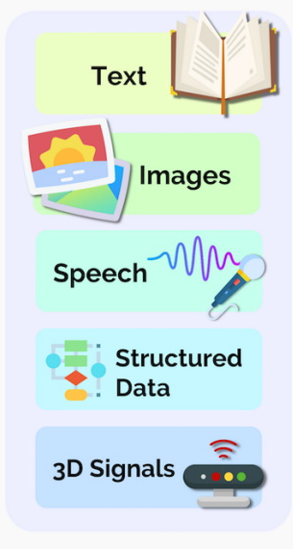
Self-Supervised Models ~ Multi-modal Models
Examples of the World
New Instances
🤖
Notes:
Generation is not just the product of AI, it is what fuels it.

Slide 16
Generative AI Technologies
Examples of the World
New Instances
🤖
Notes:
Generation is not just the product of AI, it is what fuels it.

Slide 17
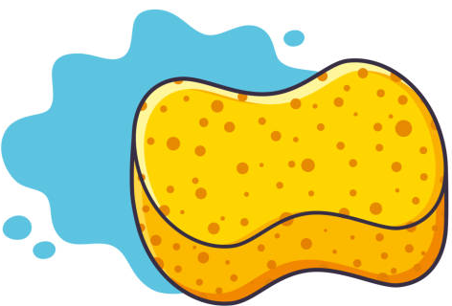
AI Models ~ Sponges
Examples of the World
New Instances
🤖
Notes:
Generation is not just the product of AI, it is what fuels it.

Slide 18
AI Models ~ Sponges
Examples of the World
New Instances
Notes:
Generation is not just the product of AI, it is what fuels it.

Slide 19
AI Models ~ Sponges
Examples of the World
New Instances
Notes:
Generation is not just the product of AI, it is what fuels it.

Slide 20
Scaling up AI Models Makes it Better
Examples of the World
New Instances
🤖
Notes:
Generation is not just the product of AI, it is what fuels it.

Slide 21
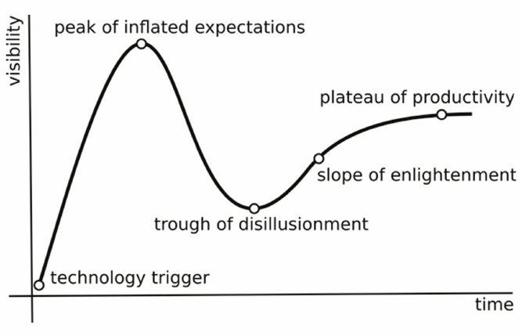
Scaling up AI Models Makes it Better Why not just scale all the way down???
Gartner's hype cycle
Notes:
gartner's hype cycle

Slide 22
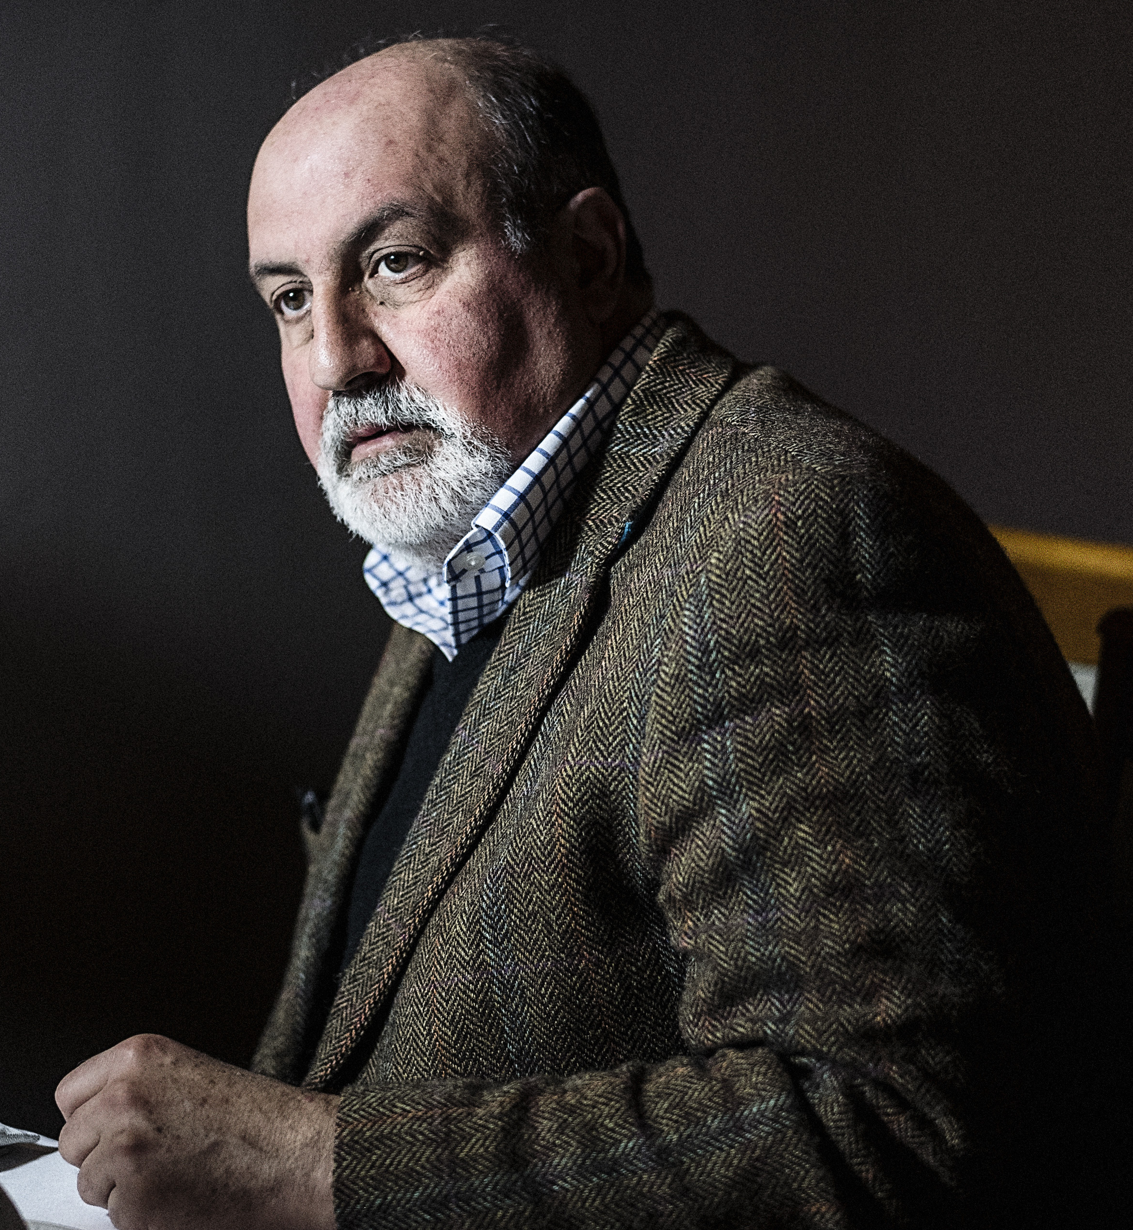
Zipf’s Law — The long tail Most things are infrequent
Nassim Nicholas Taleb suggests that biological & social dynamics lead to asymptotic distributions
Examples:
Wealth,
popularity,
number of sales of books,
number of views on social media,
frequency of a word,
many other social phenomena …

Slide 23
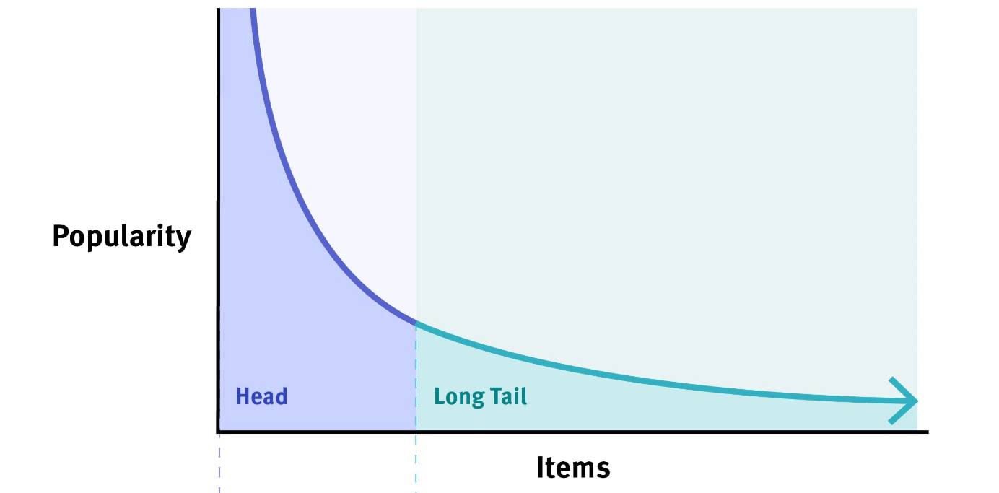
Zipf’s Law — The long tail Most things are infrequent

Slide 24
Zipf’s Law — The long tail Models’ quality depend on frequency of patterns

Slide 25
Zipf’s Law — The long tail Models’ quality depend on frequency of patterns The long tail => Hallucinations

Slide 26
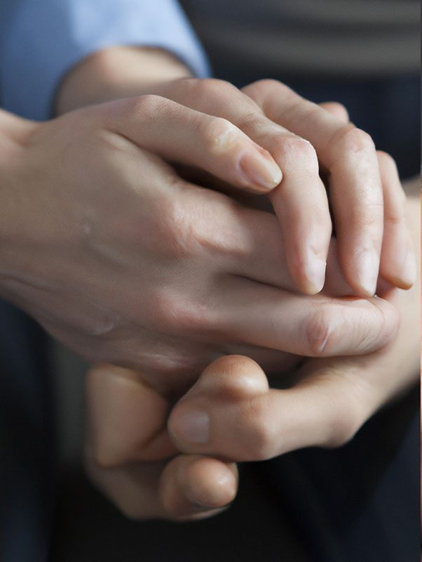
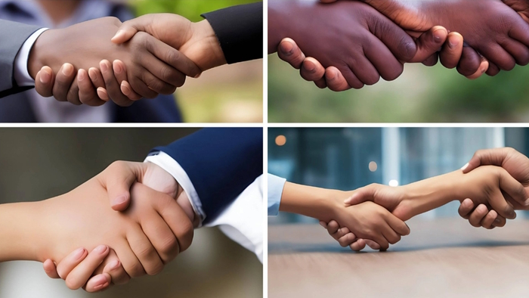
Zipf’s Law — The long tail Models’ quality depend on frequency of patterns The long tail => Hallucinations

Slide 27
Zipf’s Law — The long tail Models’ quality depend on frequency of patterns The long tail => Hallucinations
Gartner's hype cycle
Notes:
It’s a fundamental property of the nature

Slide 28
The long tail => Hallucinations Less or unobserved contexts lead to false generations
The model is not trained on enough data
The model is trained on noisy data.
The model is not given enough context
The model is mot given enough constraints.

Slide 29
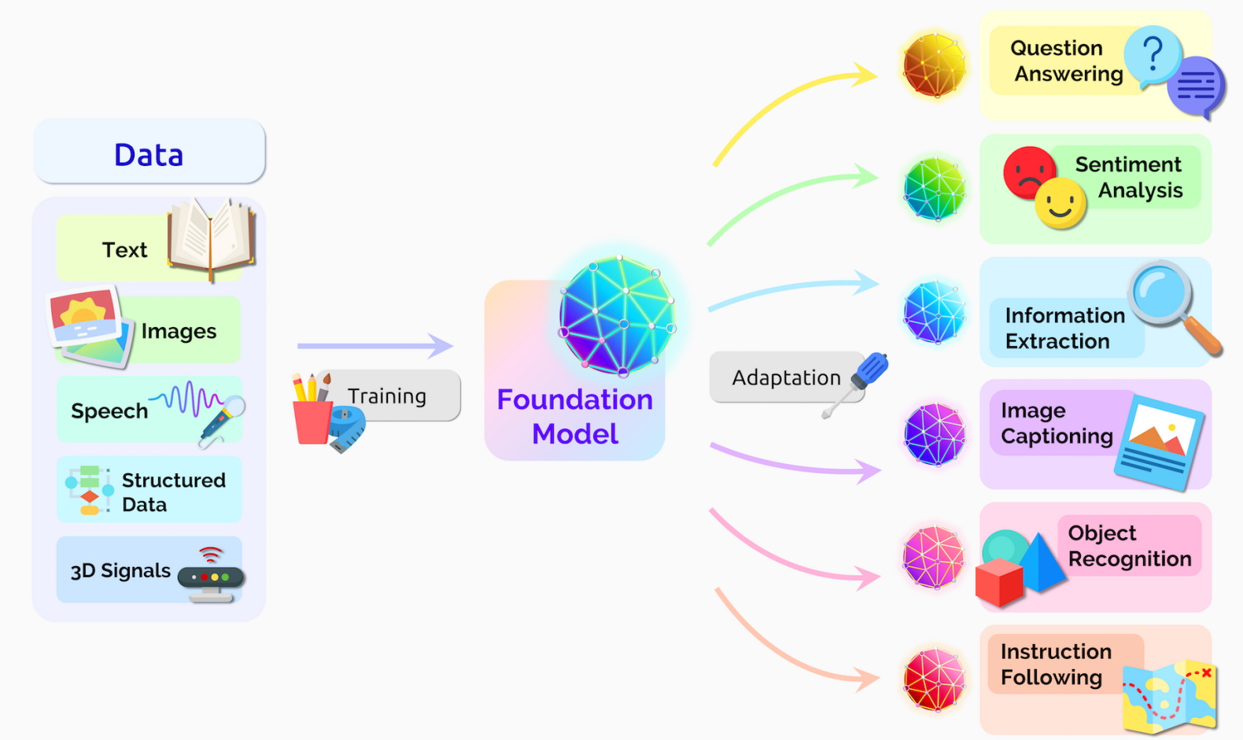
Short Term: AI as a Tool Specialized applications allow us to constrain the model to focused use cases and overcome hallucination.
Just like how calculator or microscope are tools.

Slide 30
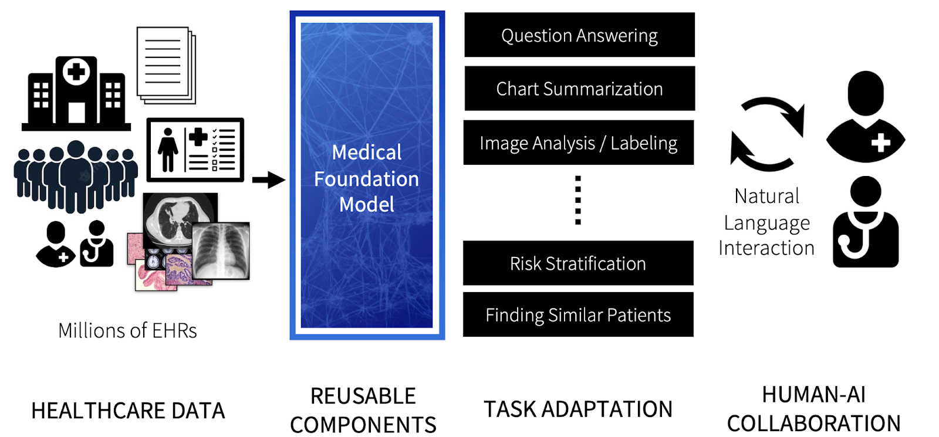
Short Term: AI as a Tool Specialized applications allow us to constrain the model to focused use cases and overcome hallucination.
Similarly in medical applications
https://hai.stanford.edu/news/how-foundation-models-can-advance-ai-healthcare

Slide 31
Highlight: Information Needs in Healthcare
Can GPT-x can serve medical information needs in a safe and concordant manner?
Experiment: Prompt models with common clinical questions:
“93% of GPT-4 responses are deemed safe”
“41% of GPT-4 responses agreed with the known answer”
“In patients at least 18 years old who are prescribed ibuprofen, is there any difference in peak blood glucose after treatment compared to patients prescribed acetaminophen?”
“Evaluation of GPT-3.5 and GPT-4 for supporting real-world information needs in healthcare delivery”, March 2023
Notes:
millions of de-identified patient records
TODO: add a box to explain “Green Button”

Slide 32
Highlight: Information Needs in Healthcare
Comparing responses of physicians vs. chatbot to patient questions
Experiment: Questions posted to a public social media forum
“.. evaluators preferred chatbot responses to physician responses in 78.6% of the evaluations.”
“Question about risk of dying following swallowing and ingesting a toothpick.”
“Comparing Physician and Artificial Intelligence Chatbot Responses to Patient Questions Posted to a Public Social Media Forum”, 2023

Slide 33
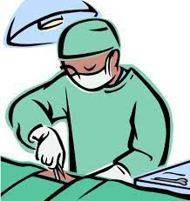
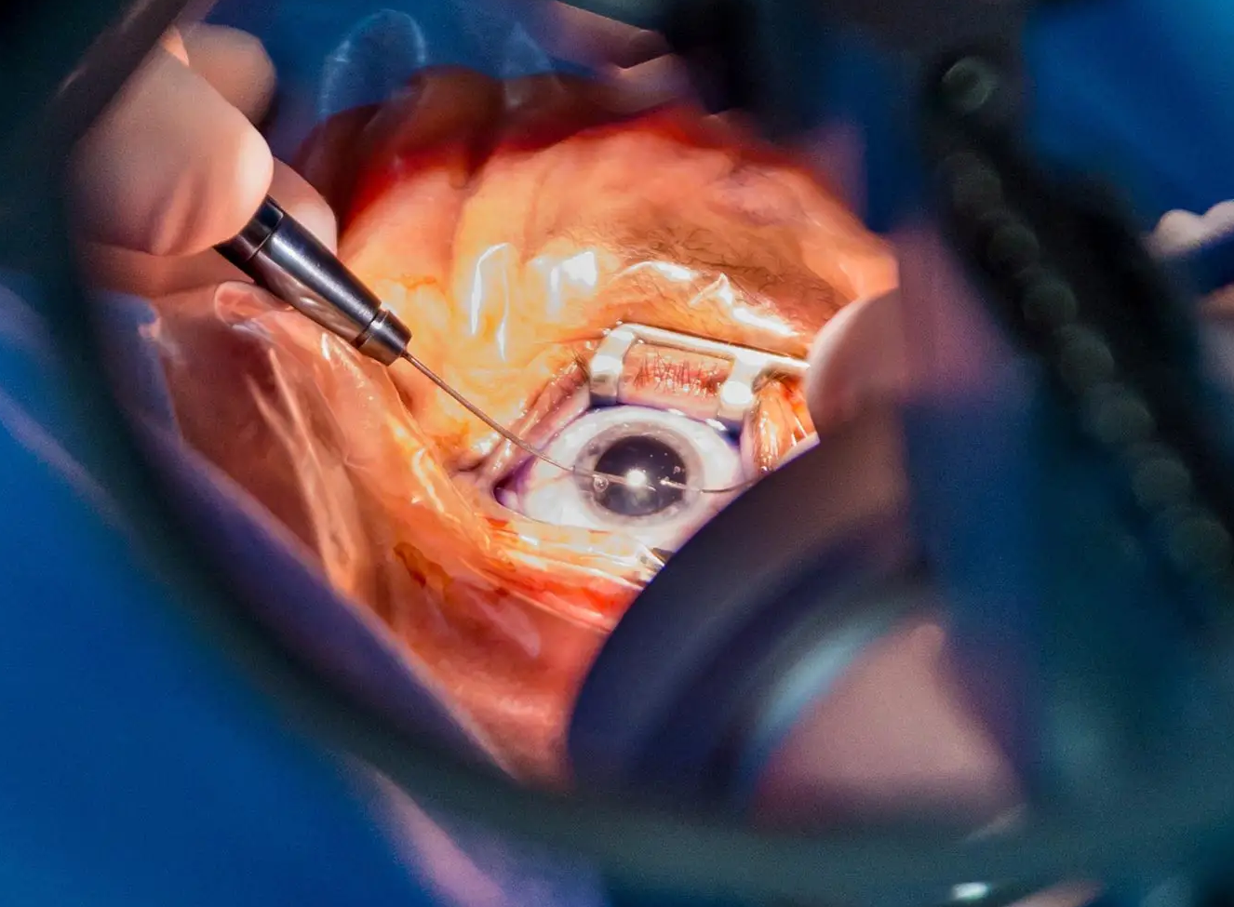
Highlight: Surgery Assistant
🤖
Goal: an assistant to surgeon
Would provide on their weaknesses
Differences with other surgeons
Can also be used for bookkeeping in surgery room
Our focus: eye surgery
The problem is much more difficult due to limited data
PIs: Swaroop Vedula, Shameema Sikder, Vishal Patel, Greg Hager, …
Notes:
TODO: mention Swaroop’s name

Slide 34
Going Forward …
Most of the success will be in domains with plenty of public data.
Example: general information needs in healthcare
Models will remain brittle in domains with limited public data.
Example: surgery

Slide 35
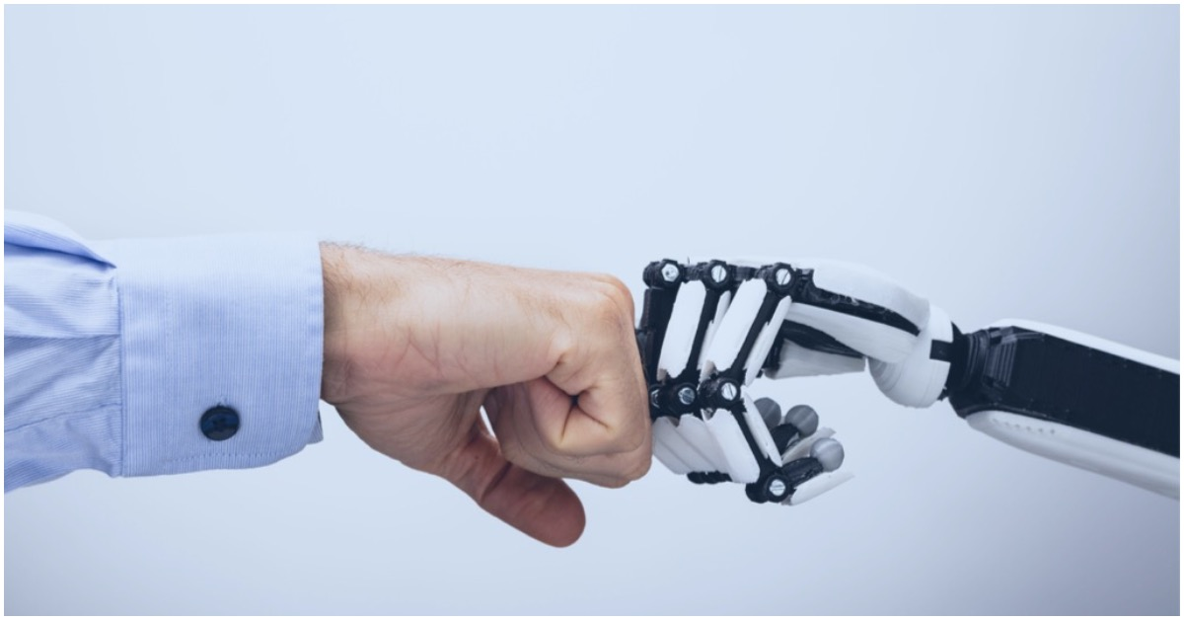
Human-AI Collaboration Human-machine complementarity will bring opportunities
Things easy for humans
What machines can do
Opportunity for human-AI colab
things that humans are slow at

Slide 36
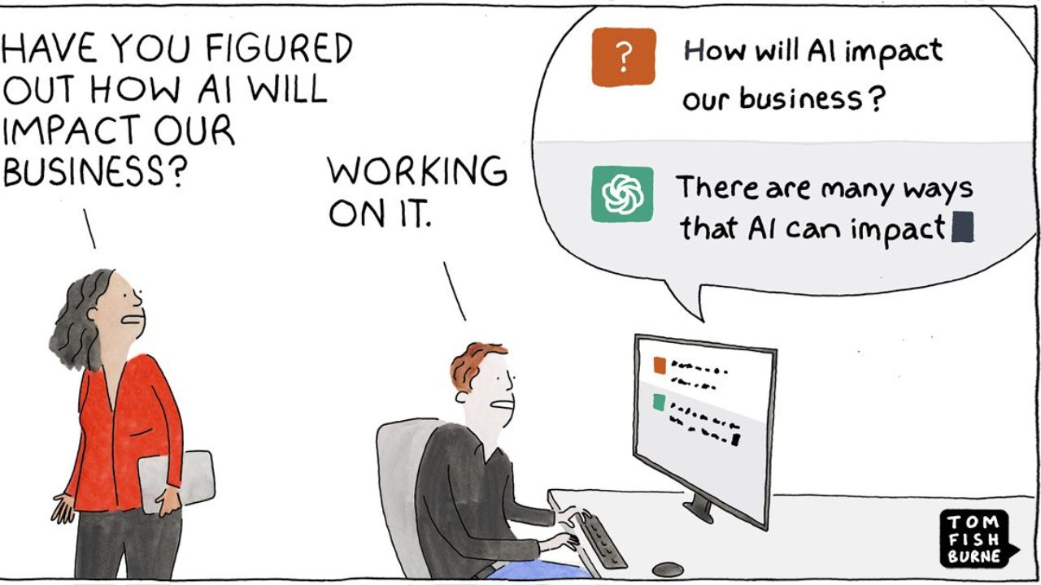

Slide 37
Let’s talk about concerns …

Slide 38

Danger: Web-Scale Poisoning
Remember we said, most of the success will be in domains with plenty of public data.
A wide range of options for “poisoning”:
Adding incorrect information
Changing the distribution of the factual data
Adding or modifying the URLs
…
Examples of the World
New Instances
🤖
“Poisoning Web-Scale Training Datasets is Practical”, 2023

Slide 39
Danger: Pushing Envelope of Privacy
For models to function, they need more data.
Collecting samples from individuals
Your emails, documents, excel sheets, medical records, biological or physical samples, TikTok pattern, etc.
Age-old question, but now:
More hunger for data
Traces of data has become less conspicuous.
Easy answer: Ultimately the choice should be with the person who is giving up the data.
But do the users know what they’re giving up?

Slide 40
Different Types of “Watching”
There are different types of watching
Caring
Gazing
Stalking
Surveilling
…
All depends on the intention/purpose.

Slide 41
Danger: Giving up Too Much + Sudden Change
Gradually we are giving up more of our autonomy.
There is a future where AI systems will be making more society-level decisions by optimizing various proxy objectives.
On most days, things will work just fine.
From time-to-time AI systems may fail catastrophically
Various society-level distributional drifts, such as a conflict between states, a natural disaster, a serious cyberattack, etc.
“What failure looks like”, Paul Christiano 2019

Slide 42

Putting it Together
I am excited and nervous.
The opportunity to make many jobs more efficient is exciting.
With expansion of digital society, there is increasing room for malicious activities in cyber space.
Notes:
I am excited and nervous.

Slide 43
Other Concerns I Didn’t Cover
Copyright policy
My take: things won’t change unless something bad happens.
Over-optimizing for market.
Example: snapchat AI
Quite concerning.
Job market:
My take: real concern, but I am optimistic.
Change will be slower than people think.
Concerns about super-intelligence
I am concerned.
Notes:
Prompt-based attacks

Slide 44
Room for Collaborations
It is likely that future regulations will involve algorithmic tests.
For example, test of whether a model has been exposed to certain copyrighted material.
We understand the technical tools and challenges.
You understand the policy/application landscape.
Dream team? 😉
Notes:
Prompt-based attacks

Slide 45
Thanks!

